Slide 1
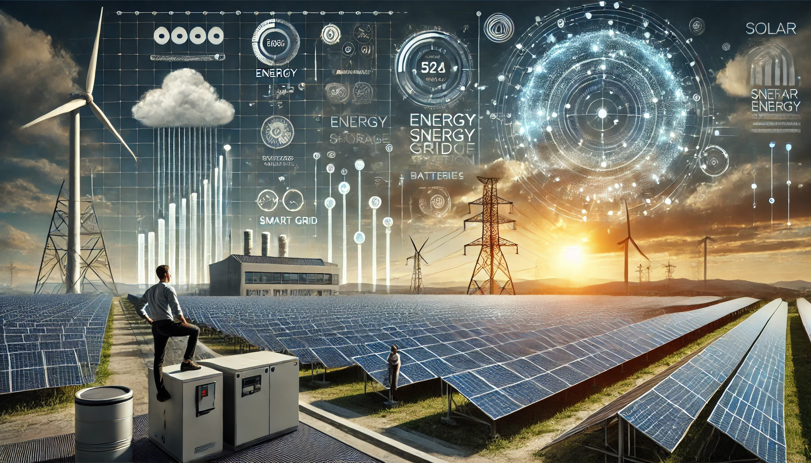

Optimization in Solar Power Generation

Slide 2

Course Name : Professional Data Analytics
Project Name : Optimization in Solar Power Generation
Mentor Name : Ms.Saikeerthi
Presenting By : Abdulrajjak Warunkar

Slide 3
Contents
Business Problem
Project Overview and Scope
Project Architecture - Data Flow Diagram
Data Dictionary
Data Collection
Exploratory Data Analysis
Data Preprocessing
Data Visualization
Notes:
Change

Slide 4
Business Problem
Business Problem: Frequent fluctuations in energy output due to variable environmental conditions and system Inefficiencies are limiting optimal solar power generation

Slide 5
Project Overview and Scope
Business Objective: Maximize Power production and Performance of the system
Business Constraint: Minimize Operational costs.
Business Success Criteria: Achieve a profit increase of 20% to 30%
Economic Success Criteria: Increase revenue by at least 20 lakhs to 30 lakhs

Slide 6
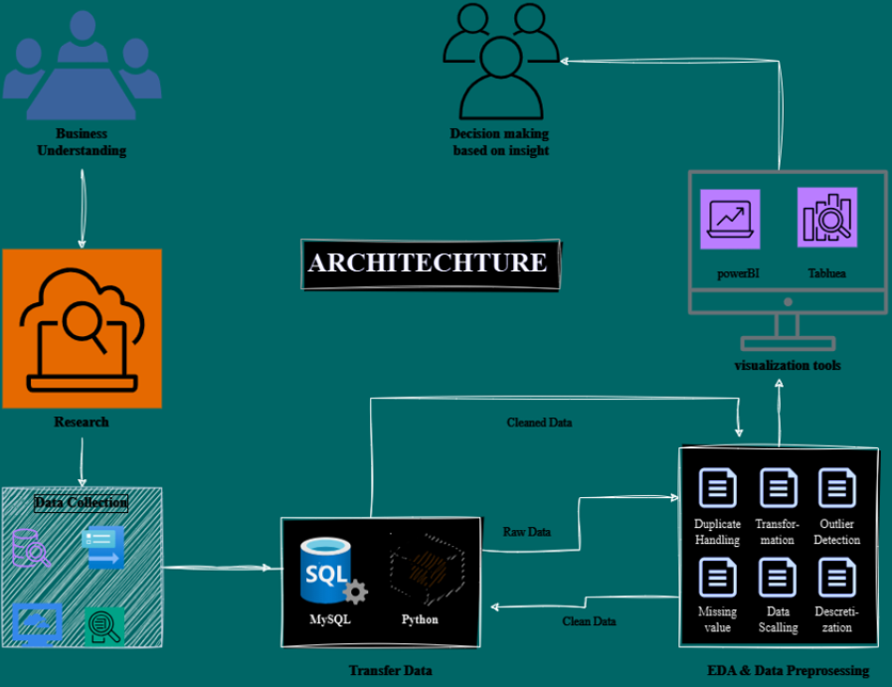
Project Architecture

Slide 7
Data Dictionary
Inverter dataset
1.DATE_TIME
2.Power_INV1_unit1
3.Power_INV1_unit2
4.Power_INV2_unit1
5.Power_INV2_unit2
WMS Report dataset
1.DATE_TIME
2.GII
3.MODULE_TEMP_1
4.RAIN
5.AMBIENT_TEMPRETURE

Slide 8
Data Preprocessing
1.Handling Missing Values:
Applied Mean, median to fill missing values in numerical columns. Replaced missing values in categorical columns with ‘Mode'.
2.Handling Duplicates:
Detected and found no duplicate rows.
3.Outlier Treatment:
Applied IQR-based capping to handle outliers.
Notes:
Keep observations

Slide 9
Exploratory Data Analysis [EDA]
Statistical Insights
Business Insights
Inverter Data
Power Readings (all units):
Mean: ~699.68 to ~711.41
Median: ~60.8 to ~67.8 (indicating skewed data with many low values)
Max: ~2739.8 to ~2887.0
Std Dev: High (~920 to ~957), reflecting variability in power output.
WMS Data
GII (Global Irradiance Index):
Mean: ~437.6
Max: 1234.0
Distribution: High variability, with a median at 399.
Module Temperature: Ranges from 0°C to 65.4°C, averaging ~42.1°C.
Rainfall: Generally low (average ~0), with rare spikes up to 4.4.
Ambient Temperature: Averages ~34.4°C, with a max of 47.6°C.
1.Peak Performance Conditions:
High GII and Module Temperature correlate with higher inverter outputs.
Optimal conditions likely occur when temperatures are moderate (~30°C–40°C).
2.Potential Operational Bottlenecks:
Significant periods of low or zero power output (median ~60) suggest inefficiencies or downtimes.
Investigate maintenance schedules, environmental disruptions (rain), or inverter overloads during these times.
3.Scalability Analysis:
Consistent periods of high power output (~2739W+) reveal the system's potential to handle peak loads.
These conditions align with high irradiance levels (e.g., ~700+ GII).
4.Impact of Weather:
Rainfall appears negligible overall but could require contingency planning during spikes.
Temperature extremes (both high and low) may warrant operational adjustments to maximize efficiency.
Notes:
EDA is used for seeing what the data can tell us before the modeling task.
Change

Slide 10
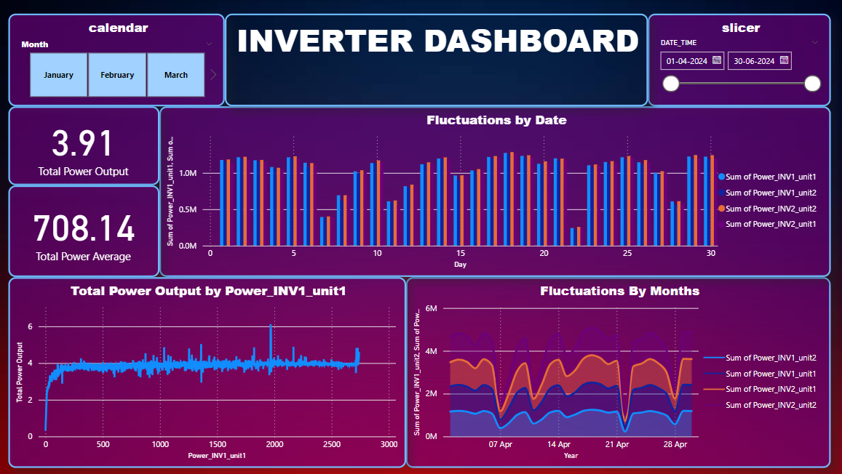
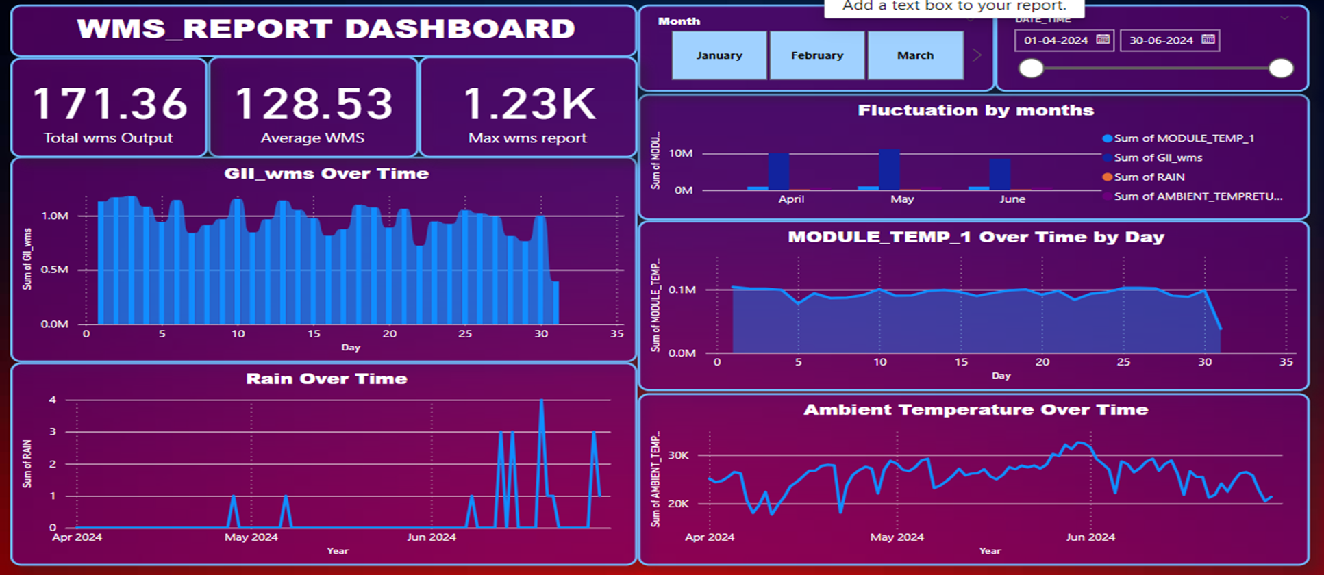
Data Visualization by Power BI
Notes:
Add graphical

Slide 11
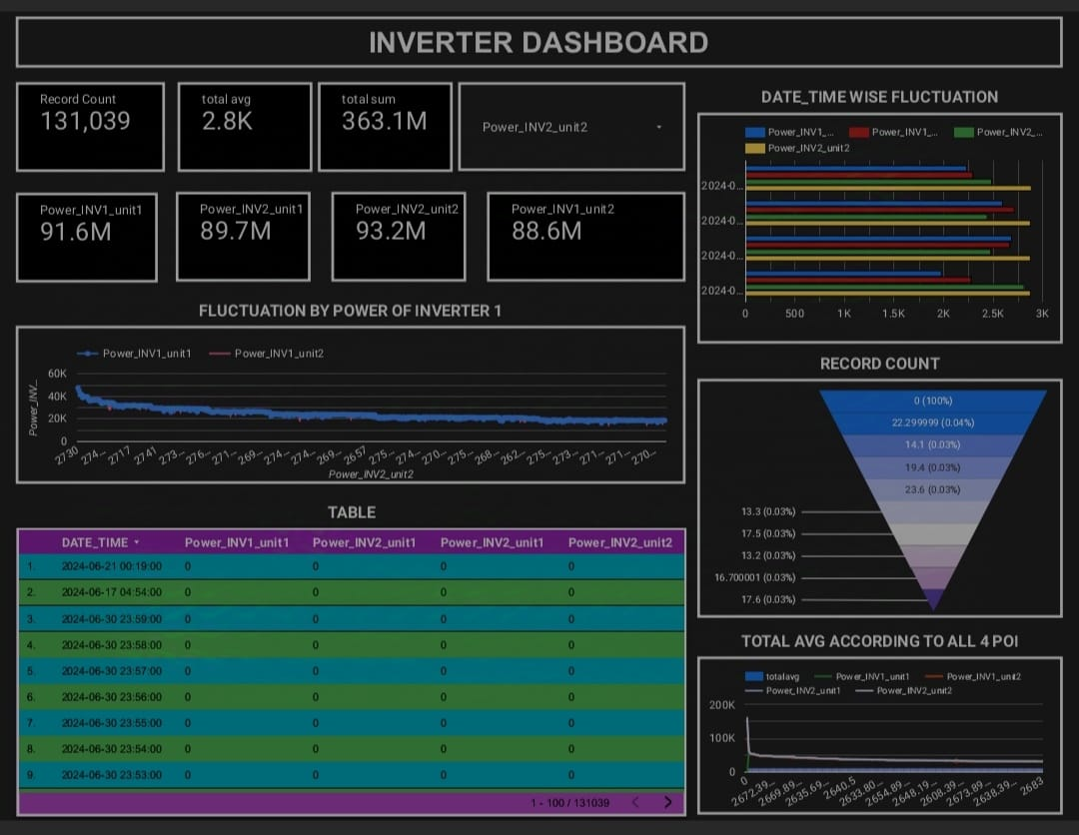
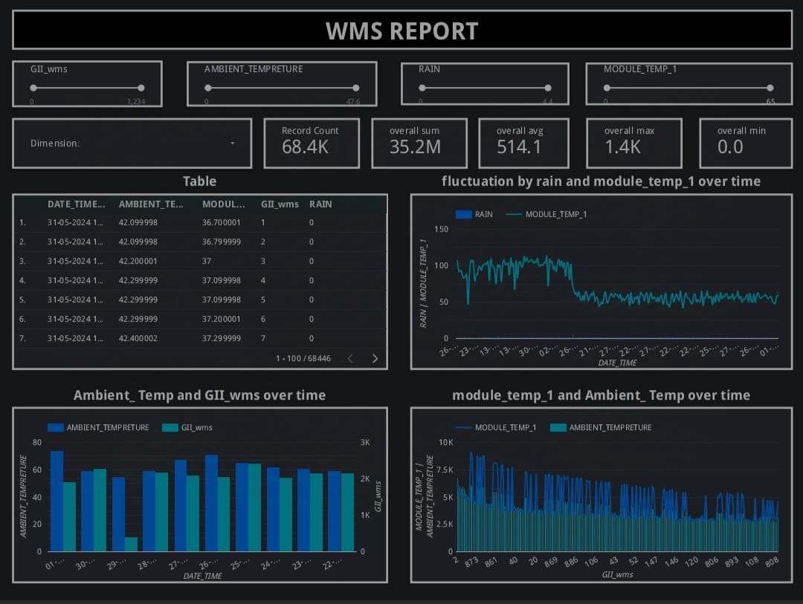

Data Visualization by Google Looker

Slide 12
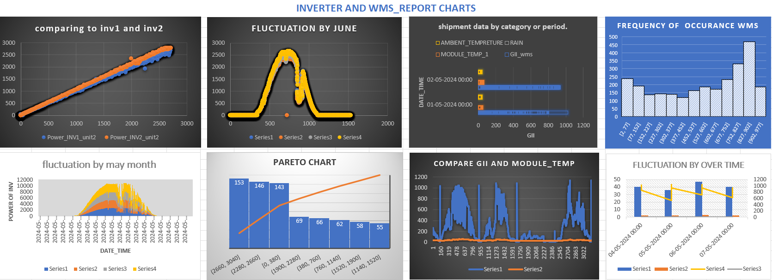
Data Visualization by Excel

Slide 13


